Slide 1
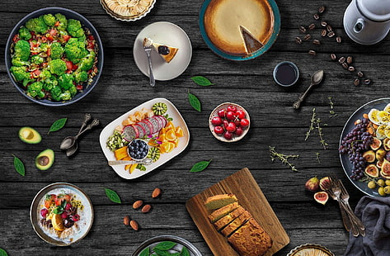
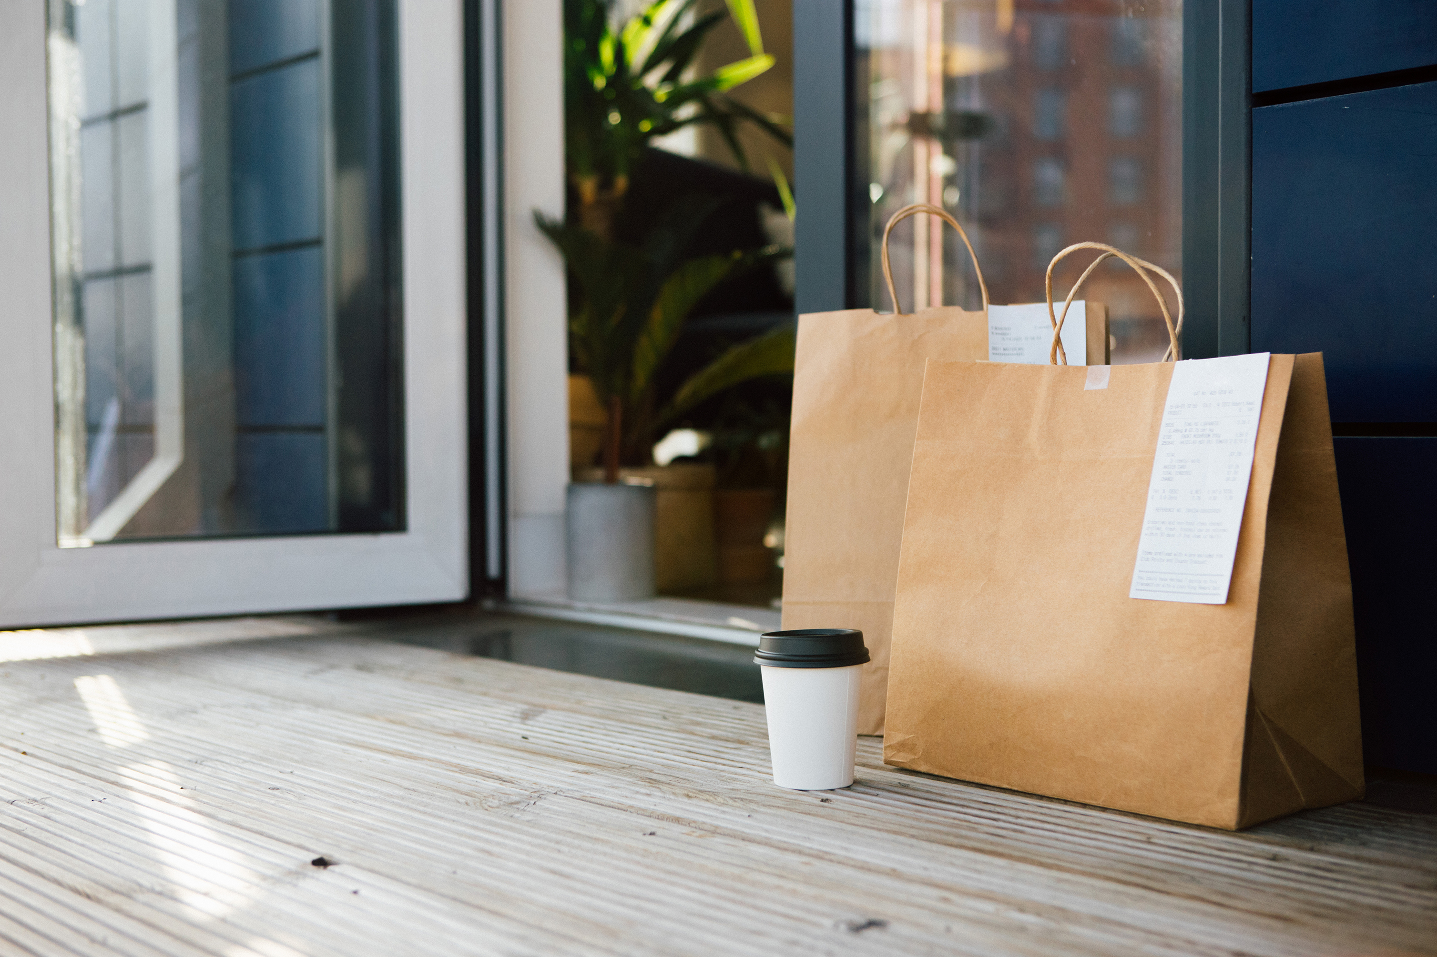
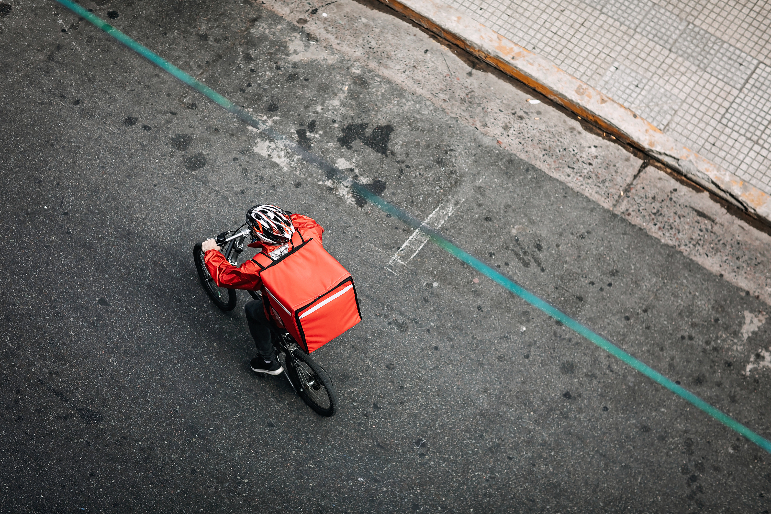
Zomato Analysis
Presented By :
Group-3 :
Ms. Riddhi B Jain
Mr. Yaswanth Polepeddi
Mrs. Vaishnavi Mayur Gaikwad
Mr. R S Ajith Kumar
Mr. Nikhil Vilas Patil
Ms. Trishti Pariwal
Mr. Ashutosh Sarjerao Shewale

Slide 2
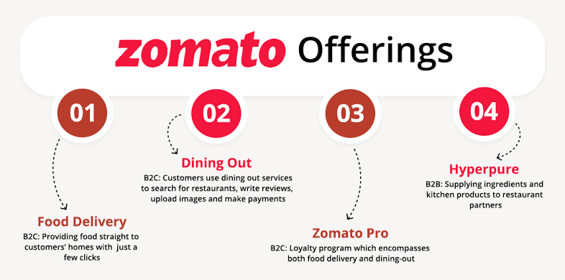
About Zomato :
Zomato’s Business Model
Zomato is an Indian food delivery startup and restaurant aggregator.
It was founded in 2008 by Deepinder Goyal and Pankaj Chaddah.
Zomato's technology platform connects customers, restaurant partners, and delivery partners.
Zomato's motto is
"discover excellent places to dine around you".

Slide 3
Objectives of Zomato :
Online food ordering and delivery
Hyperpure - Hyperpure is a B2B platform for kitchen supplies and groceries for restaurants, hotels, and caterers.
Quick commerce - Quick commerce, also known as Q-commerce, is a type of e-commerce that focuses on quick deliveries.
Their objectives also include :
Helping people to discover great places around them
Build amazing experiences around dining
Enable restaurants to create amazing experiences

Slide 4
Problems in Zomato’s Business Model :
Unsustainable - Zomato's business model is not sustainable because it relies too much on advertising revenue.
Operational challenges - Zomato faces operational challenges like delivery delays, food quality issues, and logistical problems.
Pricing strategy - Zomato's pricing strategy during the festive season could have been perceived as unaffordable or not competitive.
Competition - Zomato faced increased competition during the festive season from other food delivery platforms.
Labor costs - Each order adds to their labor costs while creating few economies of scale.
Other problems include:
Zomato is losing money on every transaction.
Their customer base is not growing fast enough.
Indian food delivery firms end up losing money on majority of orders due to high delivery costs and discounts.

Slide 5
Process of Data Modelling :
The project showcases the use of Excel, Tableau, Power BI and SQL for data analysis and visualization.
In Excel various Excel Functions were used such as :
VLOOKUP , Concatenate , Count if , Sum if , If , Report connections to link multiple PivotTables and charts to a single slicer allowing for dynamic filtering of the data , PivotTables and Pivot Charts to summarize and analyze data , DATE and YEAR functions to extract information from date fields.
Tableau was used to create interactive dashboards for the Zomato restaurant data analysis project. The following features and functions were utilized:
Data Joins to combine data from different tables , Calculated fields to perform calculations on the data , Dimensions and measures to organize and analyze the data , Visualizations such as maps, charts , custom charts , and tables to display the data , Navigation button , Filters to enable dynamic filtering of the data
Power BI was also used to create interactive dashboards. The following features and functions were utilized :
Data modeling is done by using relationships between tables and calculated columns , Measures and DAX formulas to perform calculations. Visualizations such as tables, charts, and maps to display the data , Slicers and filters to enable dynamic filtering , Drill-Down and Drill-through functionality .
MySQL - SQL queries were executed using the following keywords :
SELECT to retrieve data from specific columns , FROM to specify the table to retrieve data from , GROUP BY to group data based on specific columns , ORDER BY to sort data in ascending or descending order , Date functions ,Case and When function,
DDL and DML commands.

Slide 6
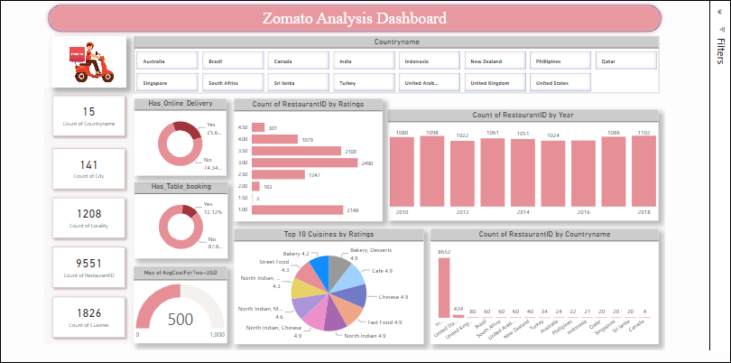
Dashboard

Slide 7
Conclusion :
A 2023 analysis of Zomato indicates that the company has a strong brand reputation and is a leader in the food delivery and restaurant discovery industry.
However, Zomato faces several challenges including intense competition and regulatory issues.
Zomato has several strengths including its innovative business model, customer focus, and ability to adapt to changing market conditions.
In conjunction with several restaurants, Zomato organizes various events and festivals to create not only revenues for itself, but also for the businesses participating.
The Business Model of Zomato is properly planned and coordinated, covering several parts of the enterprise as sources of revenue.

Slide 8
Suggestions :
Here are some suggestions for Zomato:
Improve reaching to a larger audience base.
Fixing Food quality issues to gain Customer Satisfaction.
Improving Logistical problems such as
Improper food handling,
Unreliable delivery that is Delivery delays,
To deliver the order within the promised delivery window.
It must Implement marketing Strategies such as Customers engagement through digital channels - to deal with Increased competition in the market.
Zomato must develop a Pricing strategy that would not result in business losses.

Slide 9
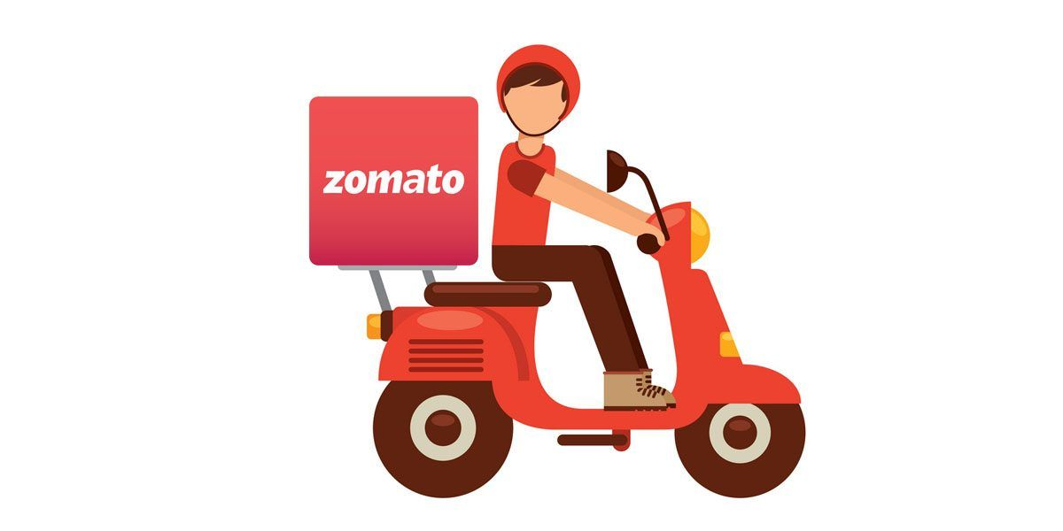
Thank You

